Slide 1
SkyShed POD
Color Study

Slide 2
SkyShed POD
POD's low cost and high quality, along with its innovative design, make it the perfect alternative to much higher priced observatory solutions
POD's Double-Wall-Design makes a HUGE difference in strength and security
SkyShed POD Weathers 120+ MPH winds
Ex: Hurricane Michael 2018

Slide 3
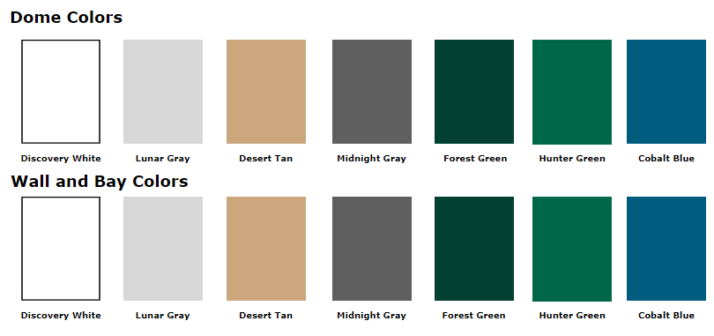
Dome, Wall & Bay Colors

Slide 4
Colors in the Field
The following slides will demonstrate popular colors of the SkyShed POD
This can help to understand what you like and don’t like
Very helpful in presenting to your spouse to get acceptance of this big thing you’re planning on putting in the backyard!

Slide 5
Colors

Slide 6
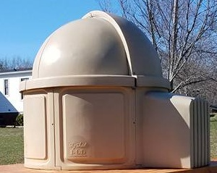
Colors

Slide 7
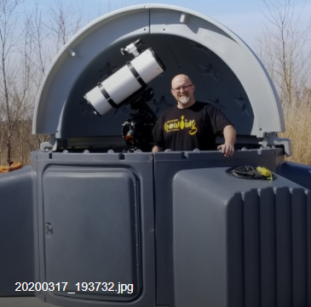
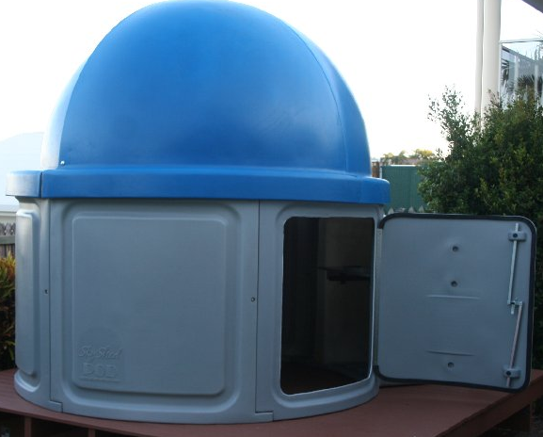
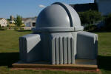
Colors

Slide 8
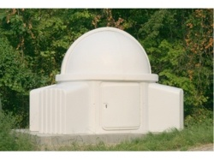
Color

Slide 9
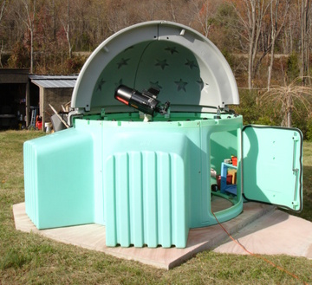
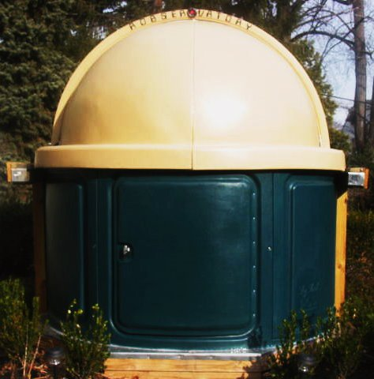
Color

Slide 10
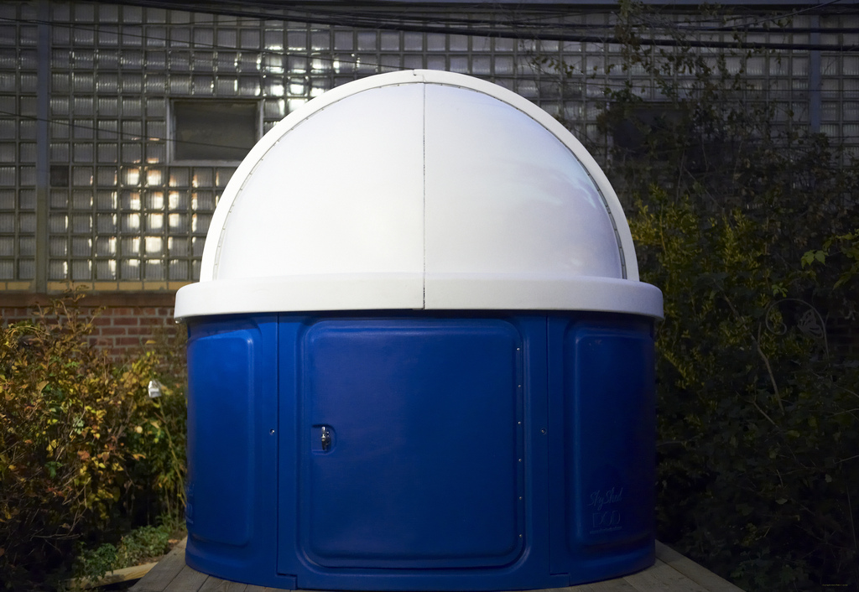
Color

Slide 11
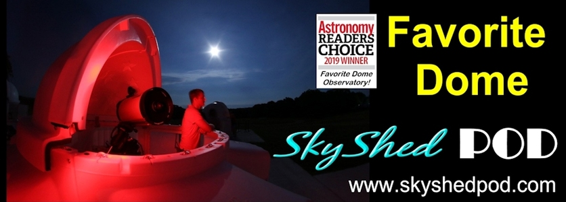
SkyShed POD

